Slide 1



Reduce DevOps Friction with Docker & Jenkins
Andy Pemberton
Solution Architecture & Consulting, CloudBees

Slide 2
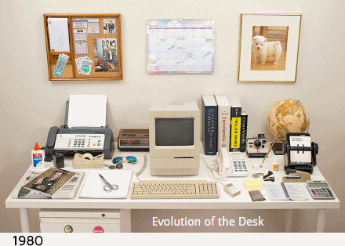
vs.
2016
Notes:
https://vimeo.com/107569286
http://bestreviews.com/best-computer-desks#history-of-the-computer-desk

Slide 3






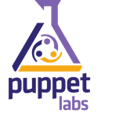
What Friction?
An example: Software Configuration Management

Slide 4
What Friction?
An example: Software Configuration Management

Slide 5


What Friction?
An example: Software Configuration Management

Slide 6

Docker’s Potential
An example: Software Configuration Management

Slide 7


Docker’s Potential
An example: Software Configuration Management

Slide 8

Reduce Friction
Docker & Jenkins have massive potential to reduce DevOps Friction
Notes:
https://upload.wikimedia.org/wikipedia/commons/b/b1/Mother_and_baby_sperm_whale.jpg

Slide 9

“Using Docker to run Jenkins build agents is ideal.”
—

Slide 10

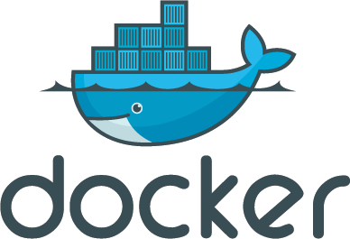
Better Together. But How?
+

Slide 11



Jenkins on Docker Hub
Top 20 Official Images
Upstream Jenkins OSS Images
Managed by CloudBees and the Jenkins Community
Over 5 million pulls
docker run jenkins
docker run cloudbees/jenkins-enterprise

Slide 12
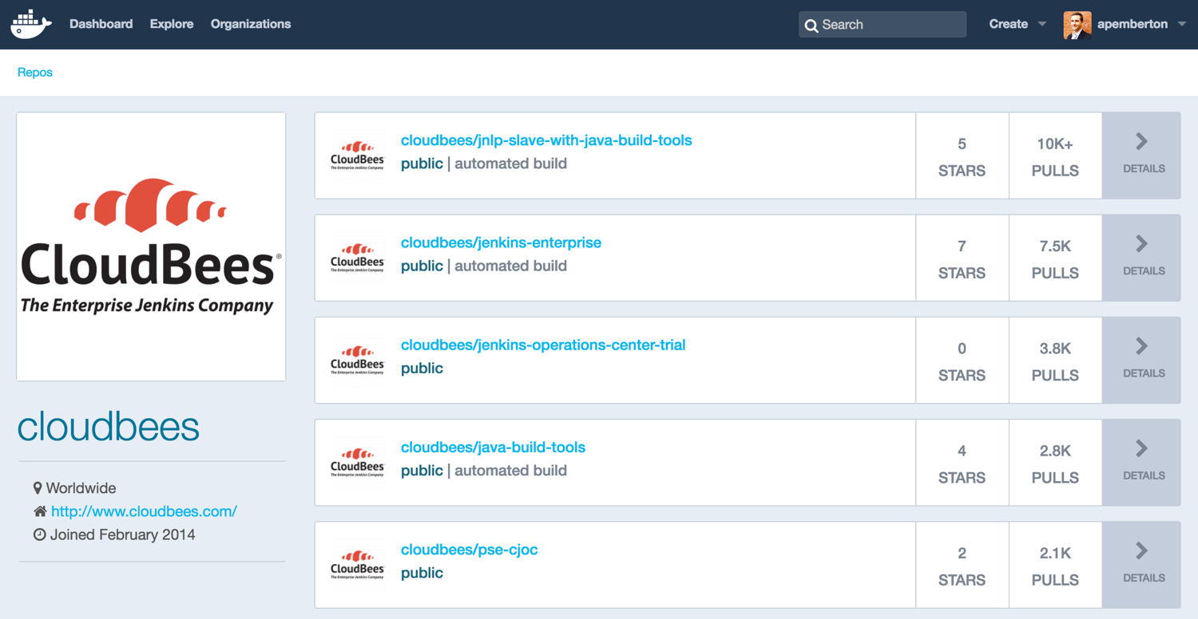

Slide 13

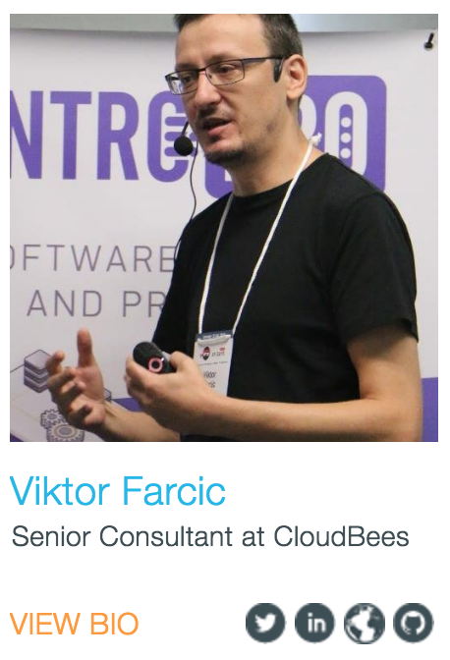

Slide 14
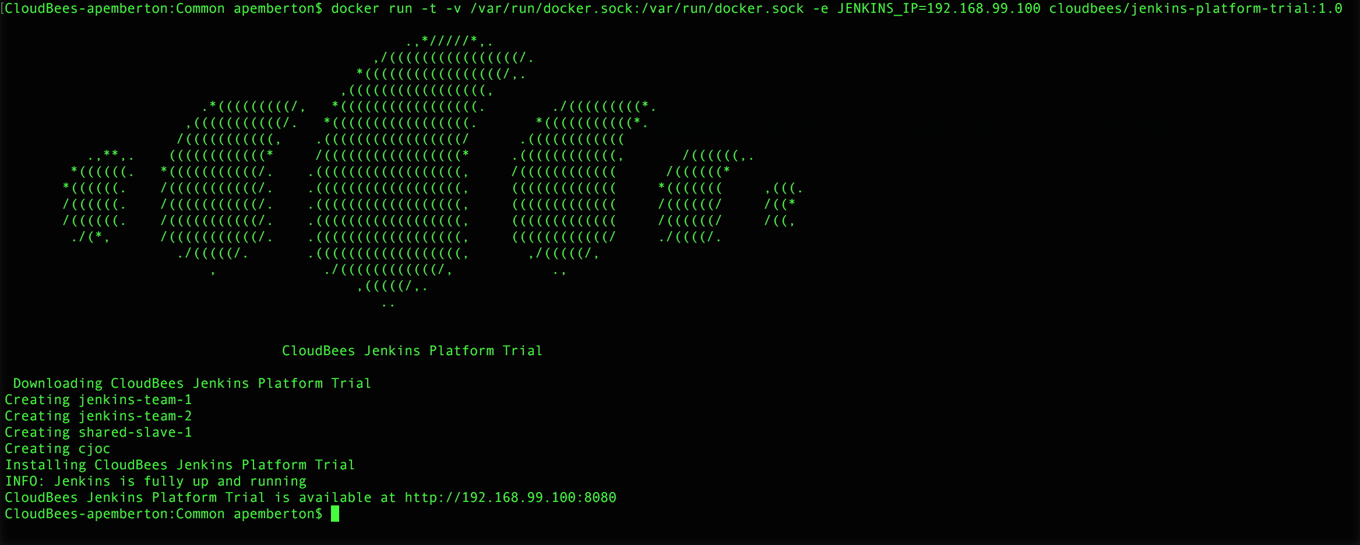
www.cloudbees.com/get-started

Slide 15


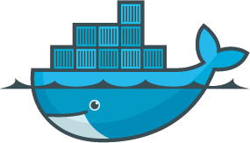

Better Together. But How?
1. Host Elastic Jenkins Environment
2. Automate Docker Image Builds

Slide 16
Host Elastic Jenkins Environment
Run and manage Jenkins masters & agents in Docker
Docker Cloud – use Docker images as standardized build environments to improve isolation and elasticity
Docker Custom Build Environment – specify customized build environments as Docker containers
Docker Shared Config. – manage Docker host configuration centrally in CloudBees Jenkins Operations Center

Slide 17



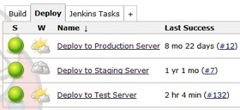
Docker Cloud
Jenkins
Agent
Jenkins Enterprise
z
Jenkins
Agent
Master
Jenkins
Agent
Notes:
Another great use-case for Docker containers is to use them for running Jenkins agents.

Slide 18
Automate Docker Image Builds
Build, Test, and Deploy Docker images from Jenkins
Build and Publish – build projects that have a Dockerfile and push the tagged image to Docker Hub
Docker Traceability – record which build pushed a particular container and display the details in Jenkins
Docker Hub Notification – trigger jobs when an image is pushed to Docker Hub

Slide 19

Docker Traceability
Record which build pushed a particular container and display the details in Jenkins

Slide 20
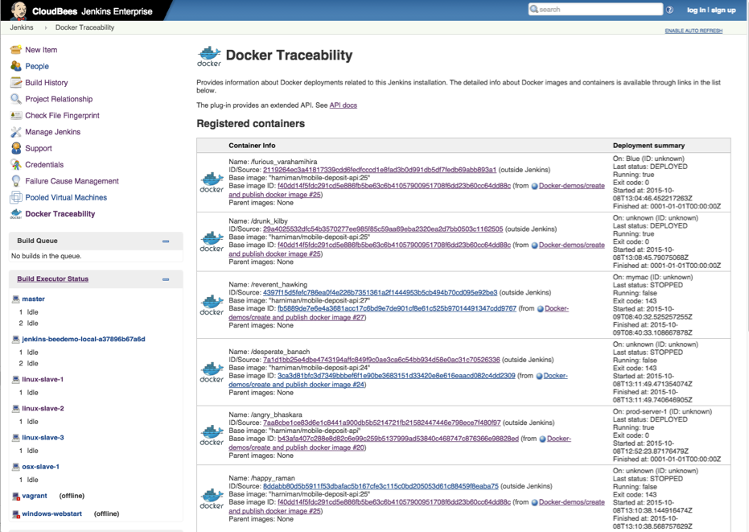
Docker Traceability
Container

Slide 21

Last but not least!
Jenkins Pipeline

Slide 22


Jenkins Pipeline + Docker
stage 'Build Source’
node('docker') {
docker.image(‘maven:3.3.3-jdk-8') {
git 'https://github.com/cloudbees/example.git'
sh 'mvn clean package'
}
}

Slide 23
Jenkins Pipeline + Docker
stage 'Build Docker Image'
node('docker') {
docker.withServer('tcp://docker.beedemo.net:2376', 'docker-credentials'){
def image = docker.build "cloudbees/example:${buildVersion}"
stage 'Publish Docker Image'
docker.withRegistry('https://registry.beedemo.net/', 'docker-reg-login'){
image.push()
}
stage 'Deploy Docker Image'
def container = image.run('--name example -p 8080:8080')
}
}

Slide 24
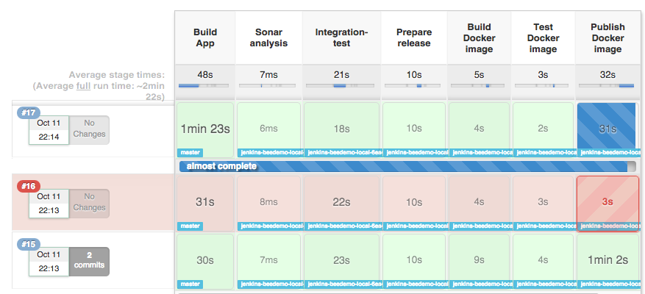
Jenkins Pipeline + Docker

Slide 25


Open Source Innovation Meets Enterprise Strength
Community Powered
DevOps Innovation
Jenkins for the Enterprise
Jenkins Platform
Jenkins OSS
Notes:
Well, that’s why CloudBees is here.
CloudBees takes the goodness in the community powered open source innovation that happens in Jenkins and makes it ready for the enterprise.
CloudBees offers the CloudBees Jenkins Platform for the enterprise which addresses all of the concerns we just discussed.

Slide 26
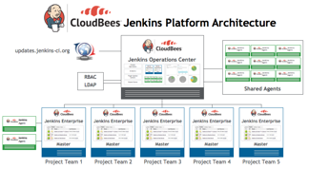


CloudBees Jenkins Platform Editions
Enterprise Edition
Private SaaS Edition
Support and features for running Jenkins @ enterprise scale
Self-Service
Docker-based
Elastic & Resilient
Private Cloud
Analytics
Shared Resources
Cloud/Container Support
Platinum Support
Gold Support
Notes:
CloudBees Jenkins Platform Enterprise Edition:
For Enterprise DevOps or application teams that want to:
Improve developer productivity by leveraging advanced developer features for Jenkins
Easily get started with continuous integration (CI) and continuous delivery (CD)
Have access to Jenkins Support experts for problem resolution
Run Jenkins operations @scale to support a large number of developers and/or teams
Optimize the performance and efficiency of the CD platform
Monitor usage and share resources across their Jenkins implementation
Have access to Jenkins support experts for quick problem resolution
Ships with All Advanced Enterprise Features for both:
CloudBees Jenkins Enterprise
CloudBees Jenkins Operations Center

Slide 27
Jenkins World 2016
The event for everything Jenkins:
community, CloudBees and ecosystem.
Santa Clara Convention Center
September 13-15, 2016
Learn more and register now!
www.jenkinsworld.com

Slide 28

Thank you!
@apemberton

